Slide 1
OSI Physical Layer
Dr. Muazzam A. Khan

Slide 2
Objectives
Explain the role of Physical layer protocols and services in supporting communication across data networks.
Describe the role of signals used to represent bits as a frame as the frame is transported across the local media.
Describe the purpose of Physical layer signaling and encoding as they are used in networks.
Identify the basic characteristics of copper, fiber and wireless network media.
Describe common uses of copper, fiber and wireless network media.

Slide 3
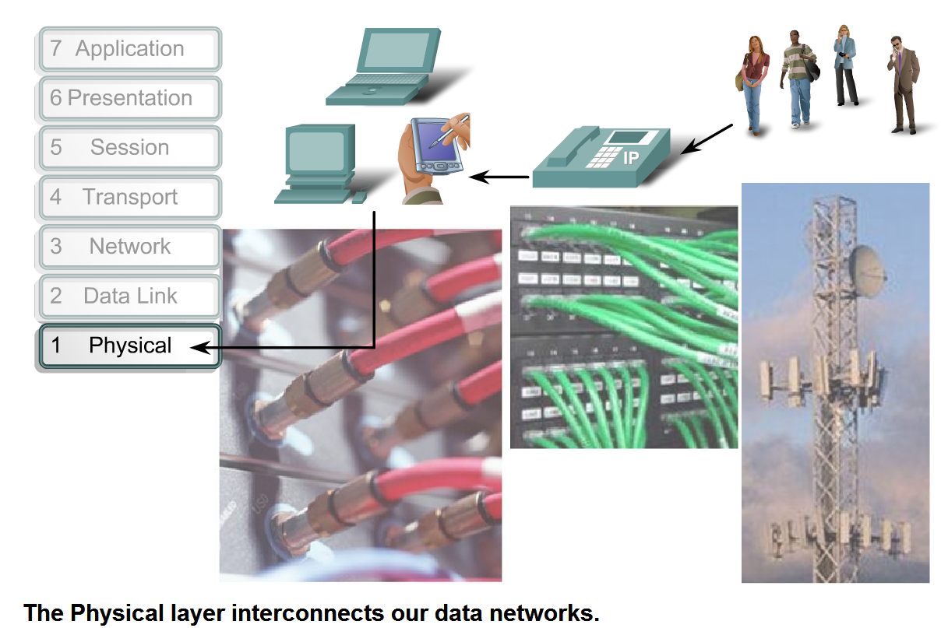
Physical Layer Protocols & Services
Purpose: create the electrical, optical, or microwave signal that represents the bits in each frame and get them on to the media.
This includes binary transmission, cable specifications, and the physical aspects of network communication.

Slide 4
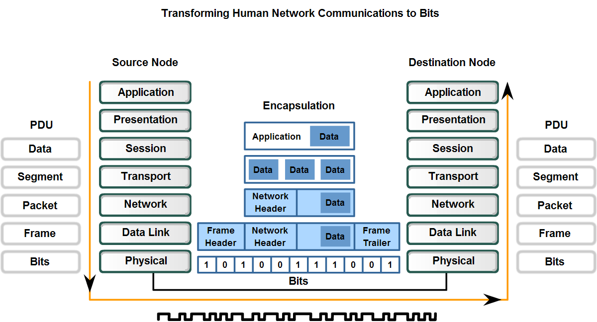
Physical Layer Protocols & Services
Frames are taken from the Data link layer and converted into bits and then into the necessary signals depending on the actual physical networking media.
These are retrieved and converted back at the receiving device.

Slide 5
Classes of Transmission Media
Conducted or Guided Media
  Use a conductor such as a wire or a fiber optic cable to move the signal from sender to receiver
Wireless or Un-Guided Media
  Use radio waves of different frequencies and do not need a wire or cable conductor to transmit signals

Slide 6
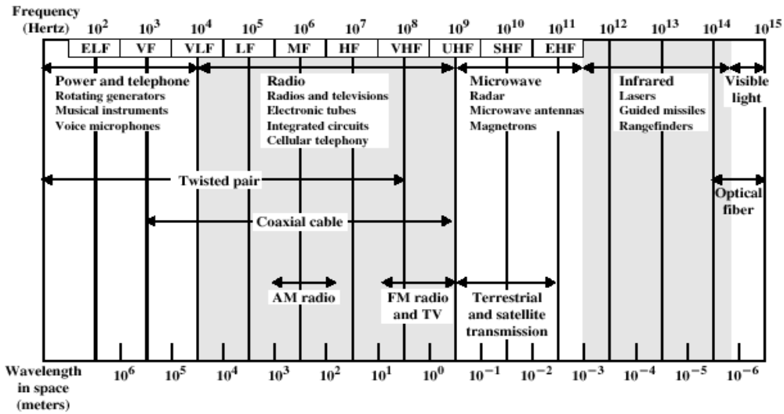
Electromagnetic Spectrum for Transmission Media

Slide 7
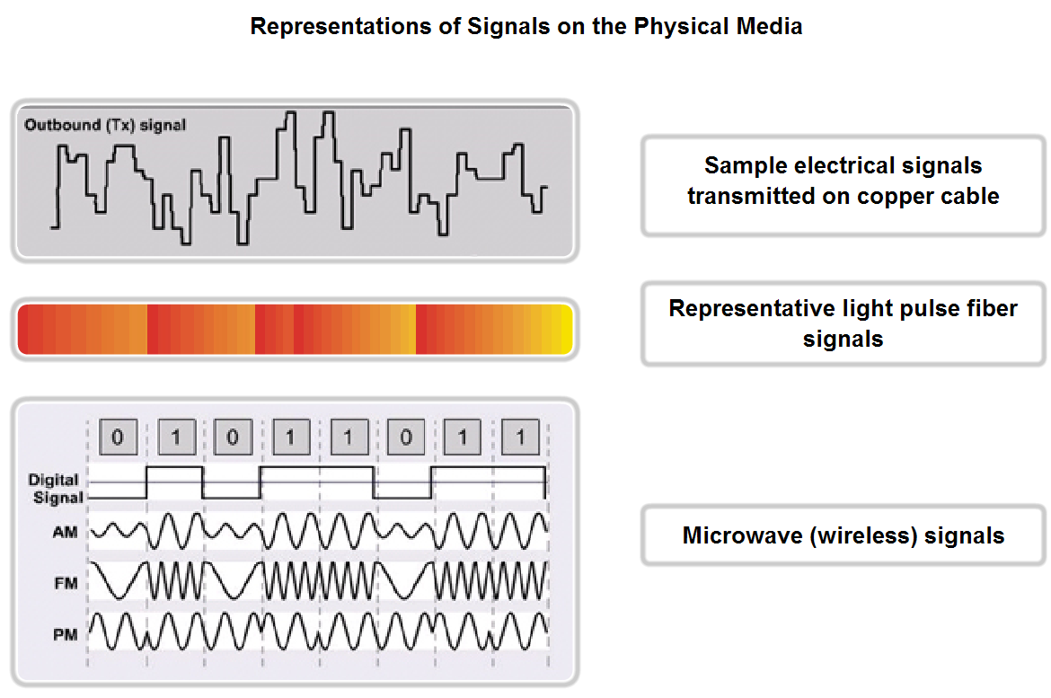
Physical Layer Protocols & Services
3 basic forms of network media: copper cable, fiber, wireless.
Copper – electrical pulses
Fiber – patterns of light
Wireless – patterns of radio transmissions

Slide 8
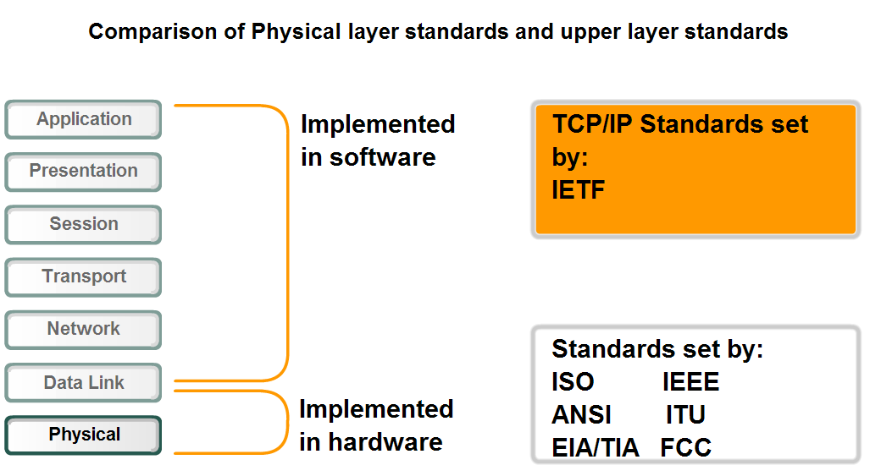
Physical Layer Protocols & Services
Physical layer standards are appropriately set by bodies who govern the hardware (relevant electrical and communications engineering organizations)

Slide 9
Physical Layer standards
4 Areas of physical layer standards
  Physical and electrical properties of the media
  Mechanical properties of the connectors.
  Bit Representation by the signals (encoding)
  Definition of control information signals
NICs, interfaces, connectors, cable materials and cable designs are all specified in these standards.

Slide 10
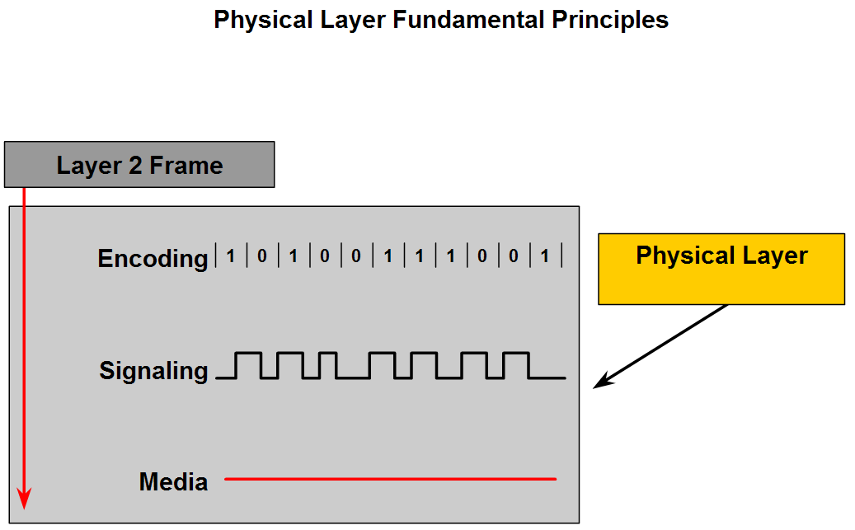
Fundamental Principles
Encoding – Converting streams of data into bit patterns
Signaling – generating the signals (electricity, light, waves) that represent the “1” and “0” on the media.

Slide 11
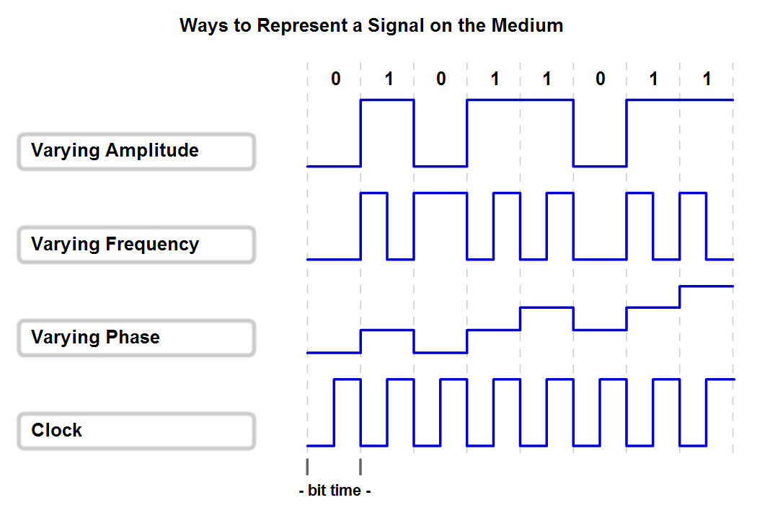
Basic Encoding Techniques
Non Return Zero – NRZ – low voltage=0, high voltage=1
Good for slow speed data links,Very susceptible to interference
Manchester encoding – voltage transitions (low > high=1, high<low=0) - Good for 10BaseT Ethernet
NRZ
Manchester

Slide 12
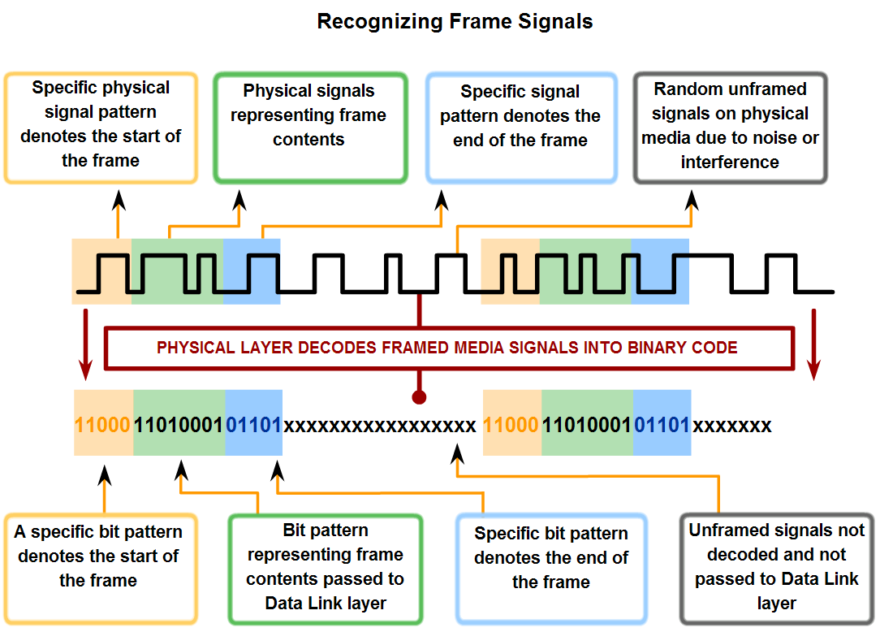
Encoding
Coding groups – A code group is a consecutive sequence of code bits that are interpreted and mapped as data bit patterns. Allows detection of errors more efficiently. Can Tx at faster speeds.
Must have start/stop frame bits for this to work

Slide 13
Measuring Data Carrying Capacity
Bandwidth – Amount of info that can flow from one place to another in a given amt of time
Throughput – Measure of transfer of bits across the media over a given period of time.
Goodput – measure of usable data transferred over a given period of time. Throughput – overhead (session establishment, acknowledgements, encapsulation, etc.)

Slide 14
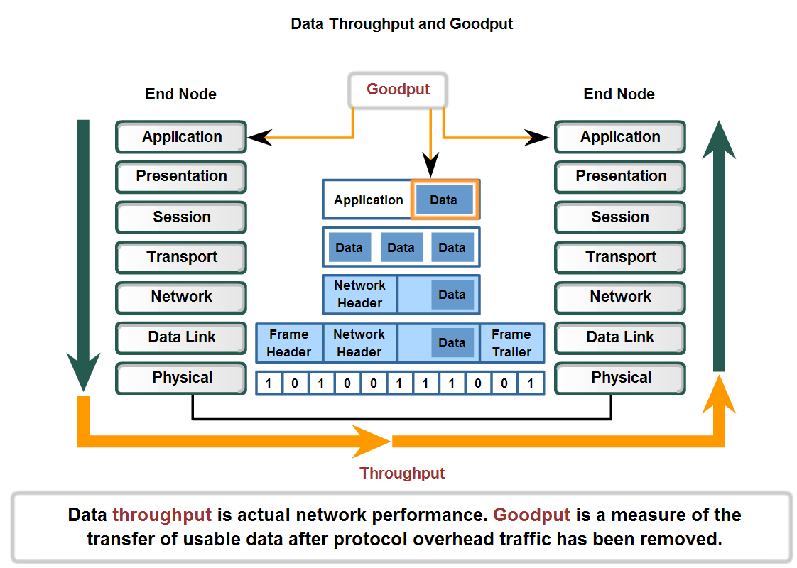
Goodput and Throughput

Slide 15
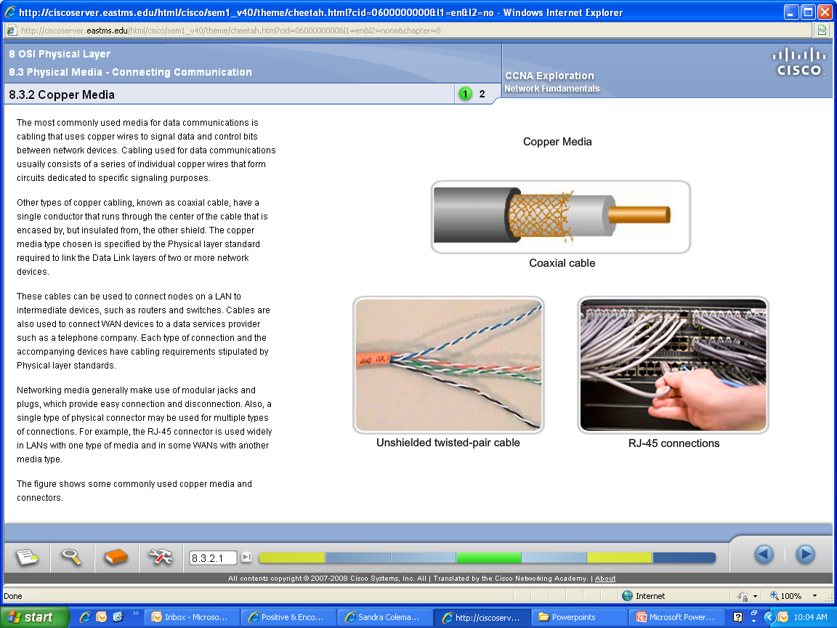
Copper Media – most commonly used

Slide 16
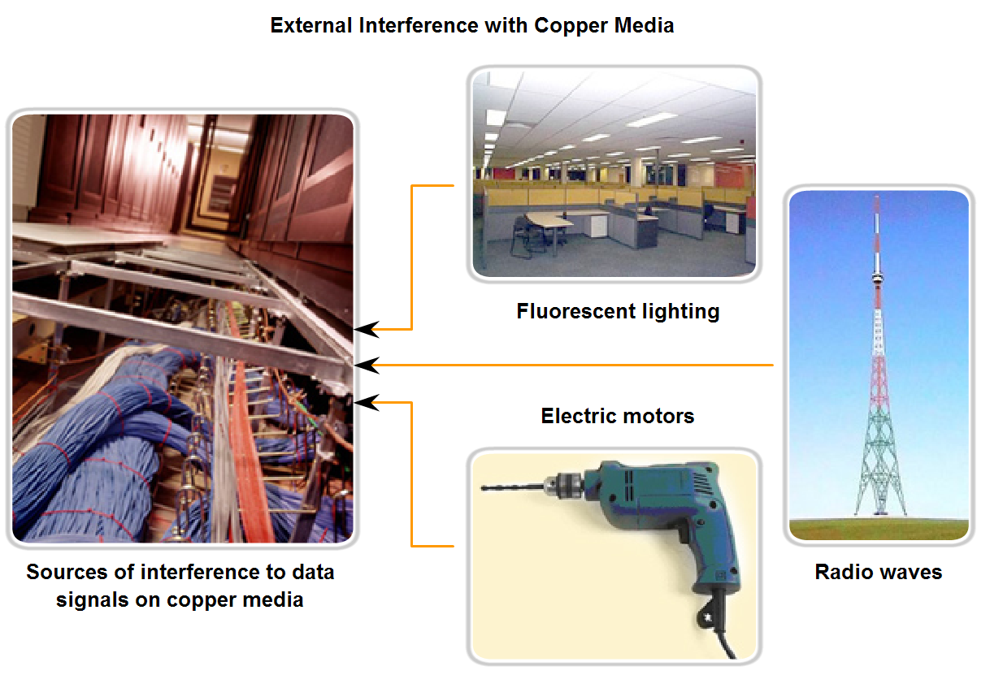
Copper Media - interference
Shielding and twisting of wire pairs are designed to minimize signal degradation due to noise.

Slide 17
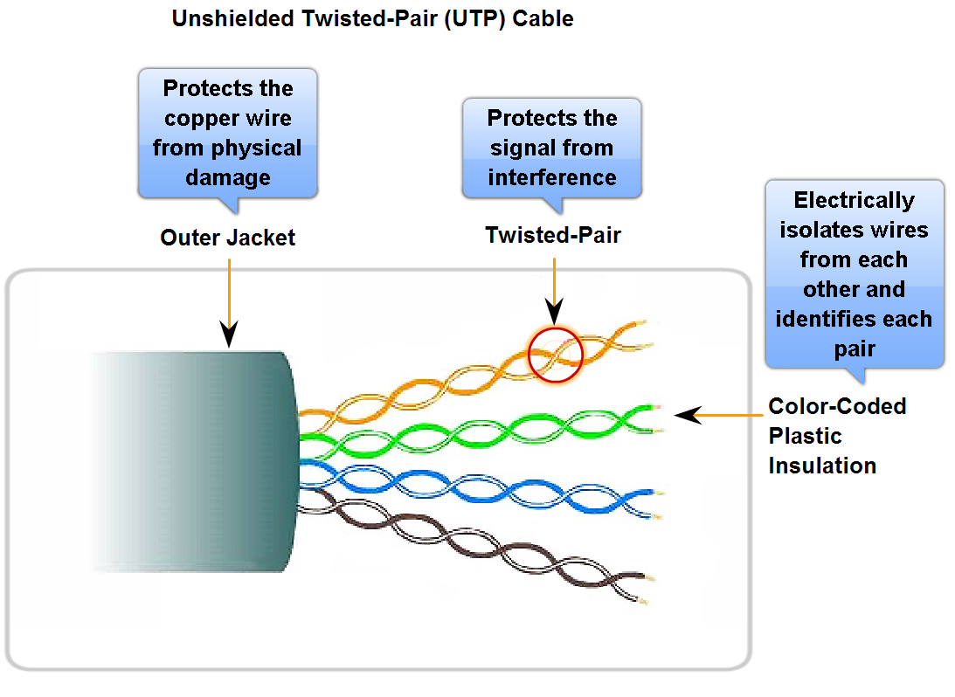
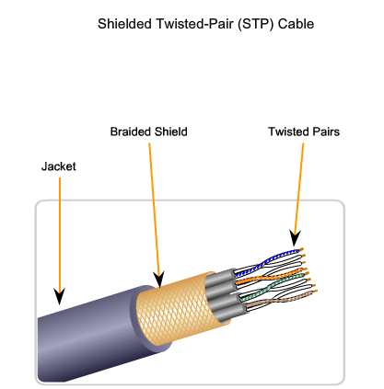
Unshielded Twisted Pair (UTP) Cable
Crosstalk – interference caused by the magnetic field around adjacent pairs of wire within the cable.
Cancellation – maintaining twists cancels out the effects of the crosstalk between the 2 twisted wires and between wire pairs.

Slide 18
3 Basic types of cables
Straight Through
Crossover
Rollover

Slide 19
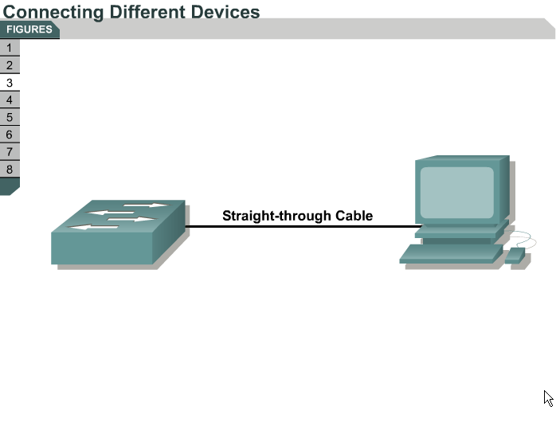
Straight Cabling
Used to Connect a network host (PC or Printer) to a network device such as a switch or hub.

Slide 20
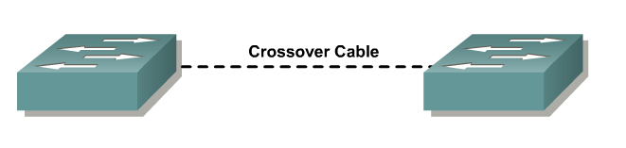
Cross Cables
Connecting two network hosts (PC to PC)
Connecting two network intermediary devices (switch to switch, or router to router, like devices).

Slide 21
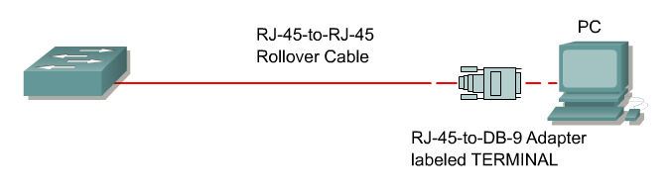
Rollover cable
Connect a workstation serial port to a router or switch console port, possibly using an adapter.

Slide 22
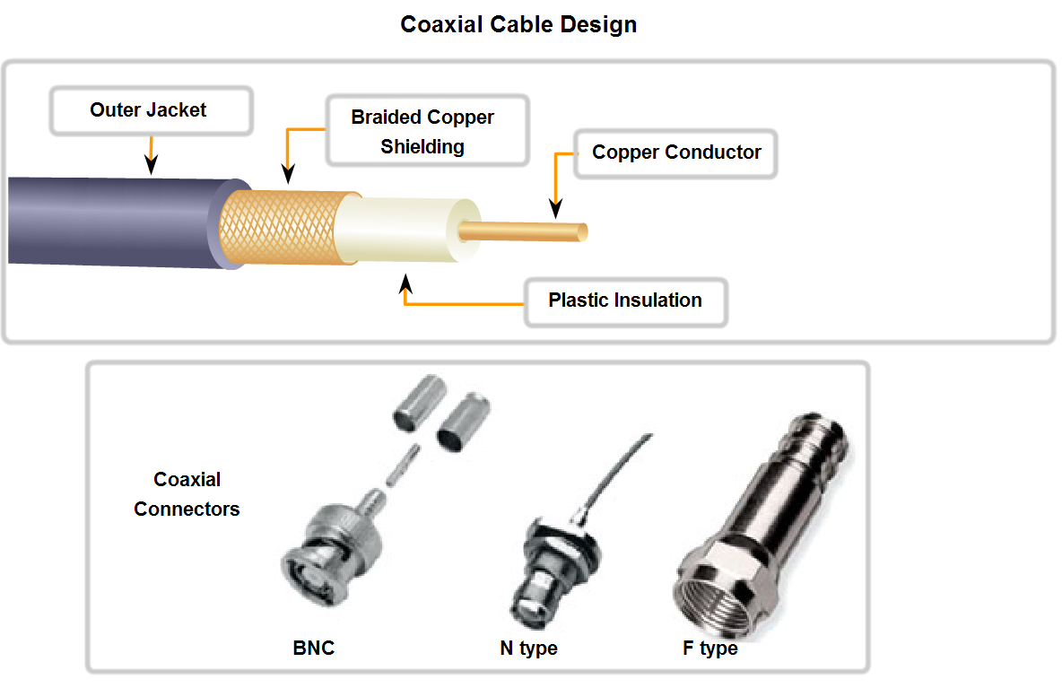
Characteristics & Uses of Network Media
Coaxial – Copper surrounded by flexible insulation. Woven copper braid or metallic foil acts as a second wire and as a shield for the inner conductor.
Cable companies who provide internet are now using a combined fiber/coax known as hybrid fiber coax (HFC)

Slide 23
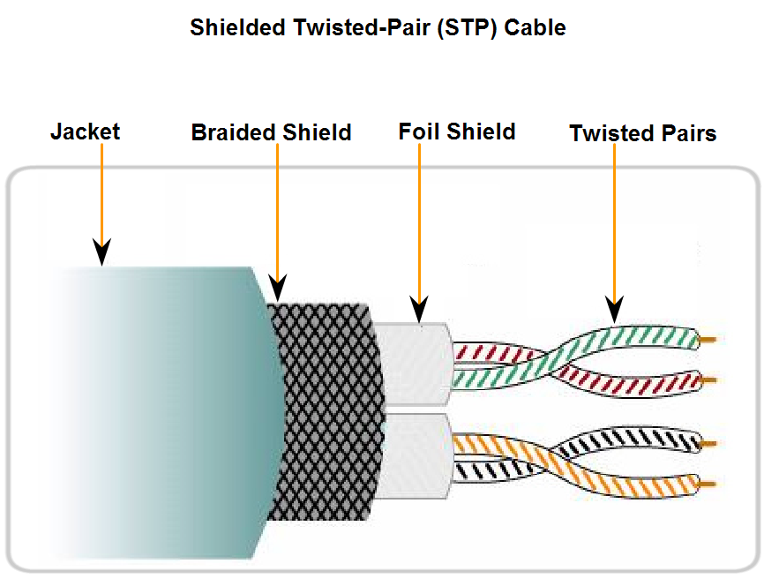
Shielded Twisted-Pair (STP) cable
Uses 4 wire-pairs wrapped in a metallic braid or foil
Shields all the wires as a bundle and each independently.
Better noise protection than UTP, but more expensive.
Used in Token-ring networks, demand is not there anymore.
10GB Ethernet has a provision for STP which may provide for renewed interest in STP

Slide 24
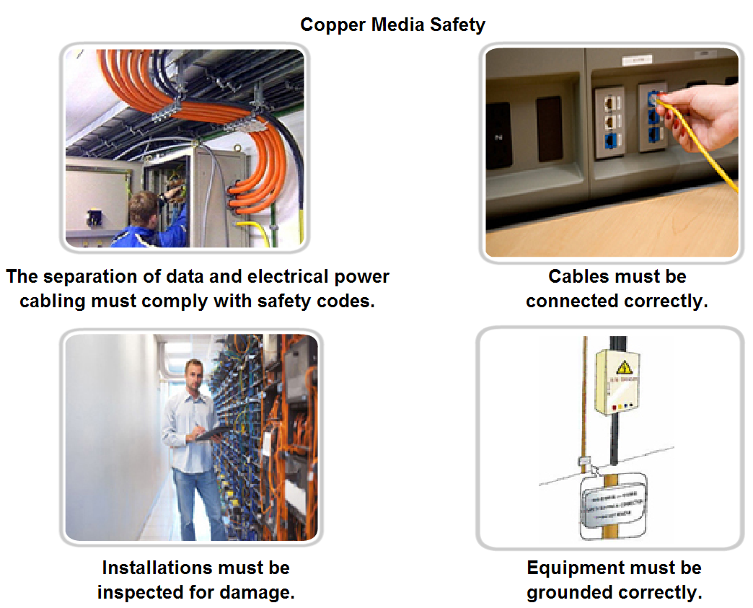
Characteristics & Uses of Network Media
Lots of ways for electricity to cause damage to devices or persons (lightening, devices with varying ground potential, etc.)

Slide 25
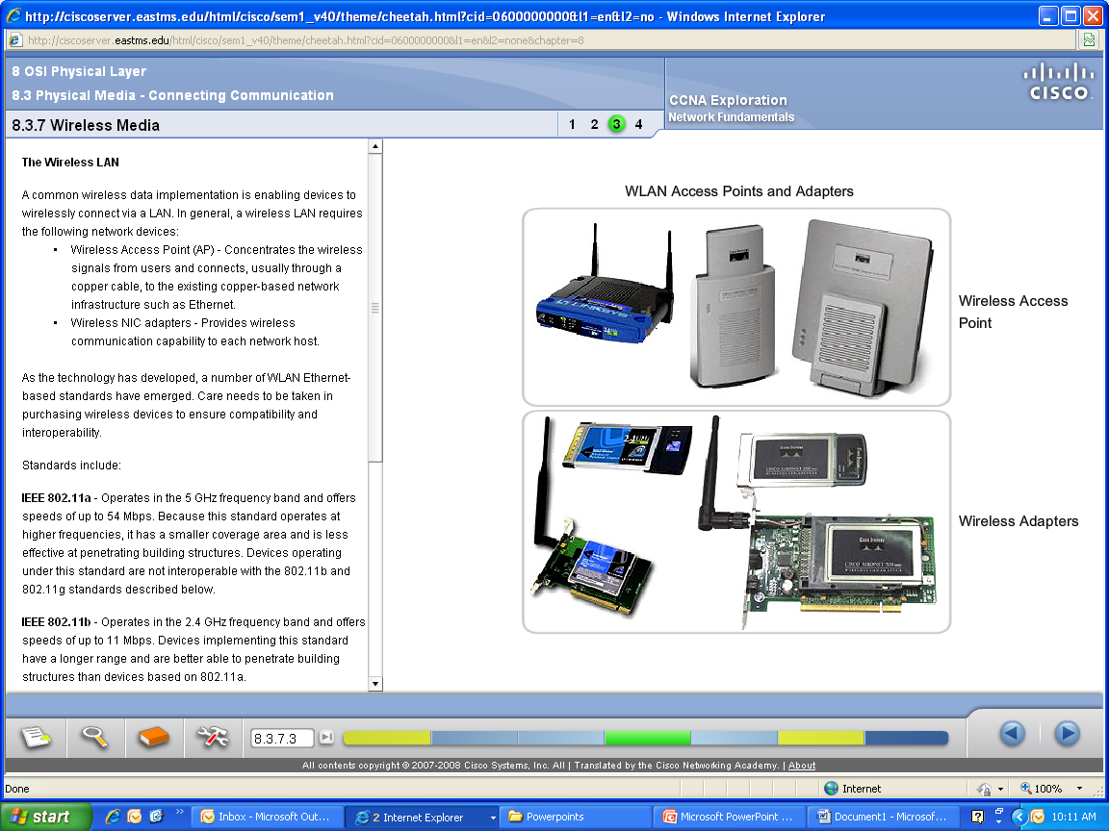
Wireless equipment

Slide 26
Types of Wireless Networks
Standard IEEE 802.11 - Commonly referred to as Wi-Fi, is a Wireless LAN (WLAN) technology that uses a contention or non-deterministic system with a Carrier Sense Multiple Access/Collision Avoidance (CSMA/CA) media access process.
Standard IEEE 802.15 - Wireless Personal Area Network (WPAN) standard, commonly known as "Bluetooth", uses a device pairing process to communicate over distances from 1 to 100 meters.
Standard IEEE 802.16 - Commonly known as Worldwide Interoperability for Microwave Access (WiMAX), uses a point-to-multipoint topology to provide wireless broadband access.
Global System for Mobile Communications (GSM) - Includes Physical layer specifications that enable the implementation of the Layer 2 General Packet Radio Service (GPRS) protocol to provide data transfer over mobile cellular telephony networks.

Slide 27
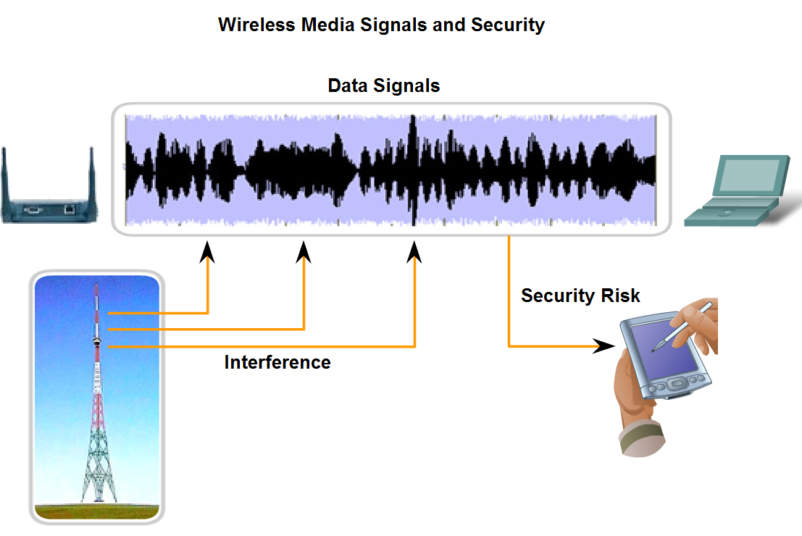
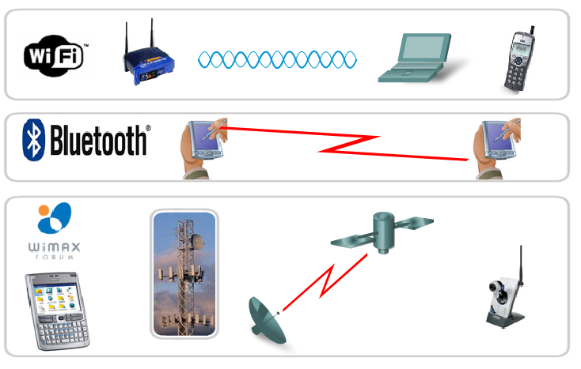
Wireless Media
Uses radio waves to carry signals. Gives you mobility (convenience) not bandwidth!
Interference from cordless phones, some fluorescent lights, microwaves, other wireless devices.
Network security is a big issue!

Slide 28
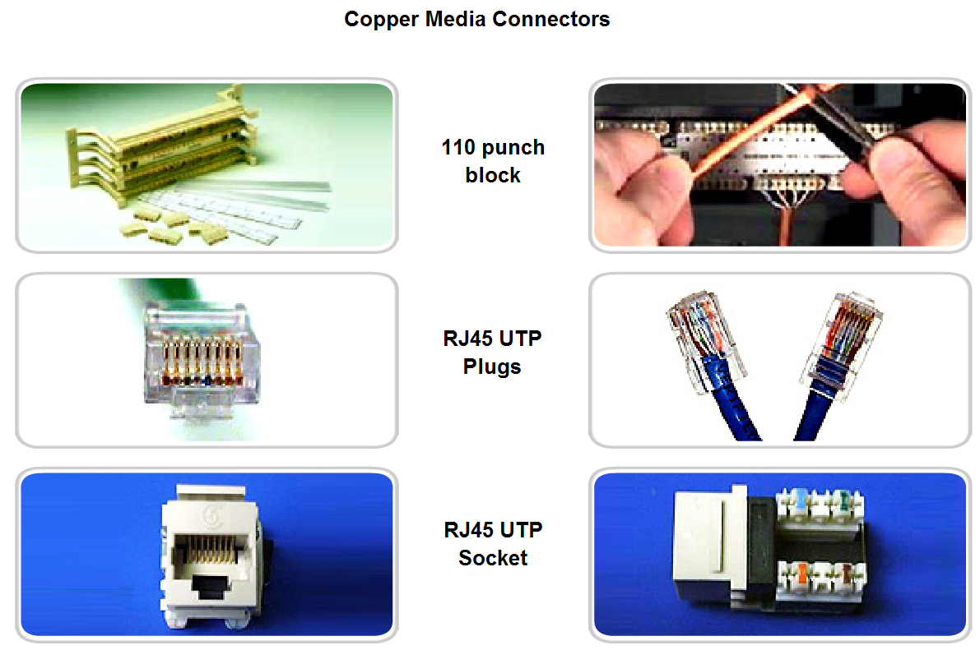
Media connectors

Slide 29
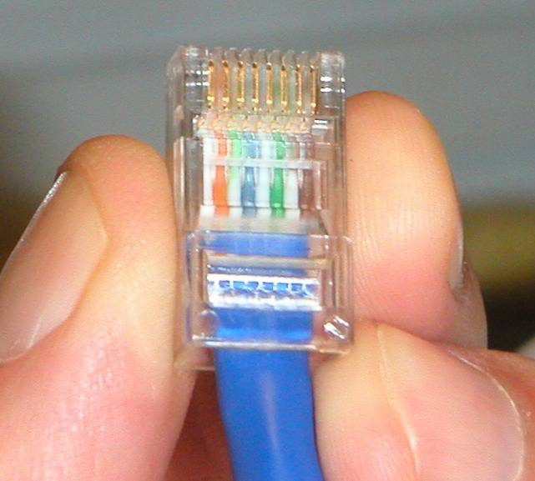
Correctly terminated RJ-45 connector
Improperly terminated cables can cause a signal loss and therefore data loss.

Slide 30
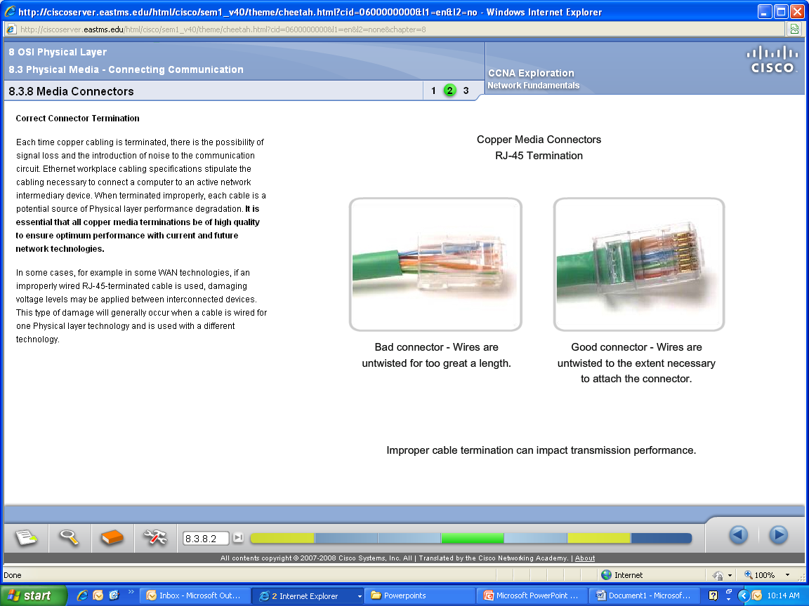
Proper vs. improper connection

Slide 31
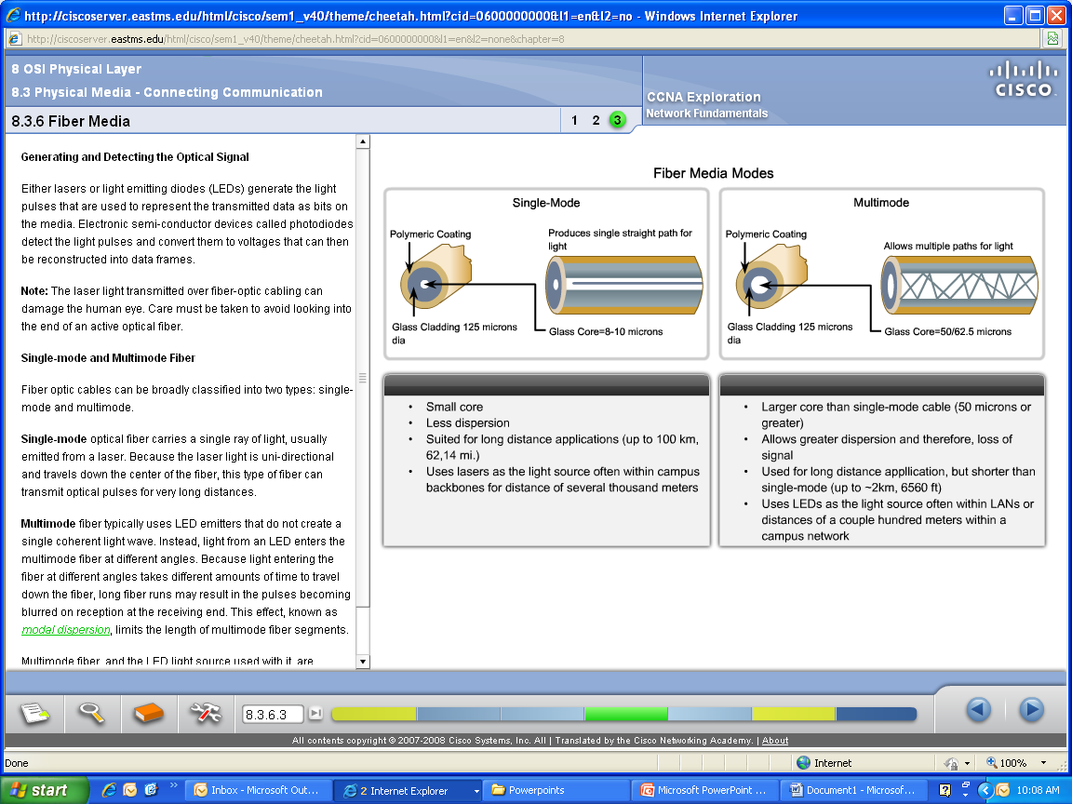
Fiber
Main advantage – NO EMI or RFI. Use primarily for BACKBONE cabling.
Disadvantage – Most expensive

Slide 32
Fiber Optic Types
Multimode step-index fiber
  The reflective walls of the fiber move the light pulses to the receiver
Multimode graded-index fiber
  Acts to refract the light toward the center of the fiber by variations in the density
Single mode fiber
  The light is guided down the center of an extremely narrow core

Slide 33
Fiber Optic Signals
fiber optic multimode
step-index
fiber optic multimode
graded-index
fiber optic single mode

Slide 34
What are optical fibers
Thin strands of pure glass
Carry data over long distances
At very high speeds
Immune to electromagnetic noise
Light in weight
Unaffected by atmospheric agents

Slide 35
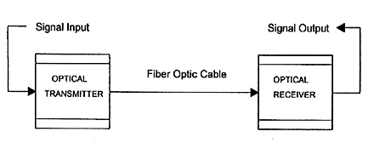
Fiber optic technology
Sources
Transmission medium
Detectors
Fig: The fiber optic communication system

Slide 36

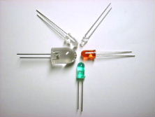
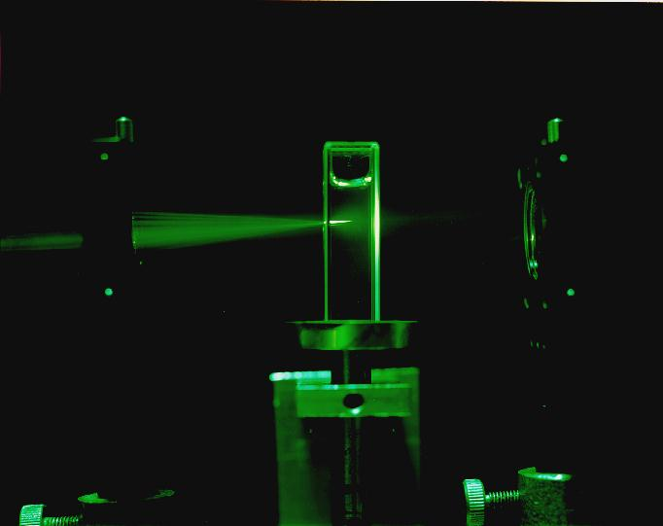
Sources of light
Light emitting diodes
Lasers

Slide 37
Types of optical fibers
Single mode
  only one signal can be transmitted
  use of single frequency
Multi mode
  Several signals can be transmitted
  Several frequencies used to modulate the signal

Slide 38
Types of optical fibers
Single mode
  only one signal can be transmitted
  use of single frequency
Multi mode
  Several signals can be transmitted
  Several frequencies used to modulate the signal

Slide 39
Fiber connectors
Straight-Tip Connector (ST) a very common type connector widely used with multimode fiber.
Subscriber Connector (SC) - a connector that uses a push-pull mechanism to ensure positive insertion. This connector type is widely used with single-mode fiber.
Lucent Connector (LC) - A small connector becoming popular for use with single-mode fiber and also supports multi-mode fiber.

Slide 40
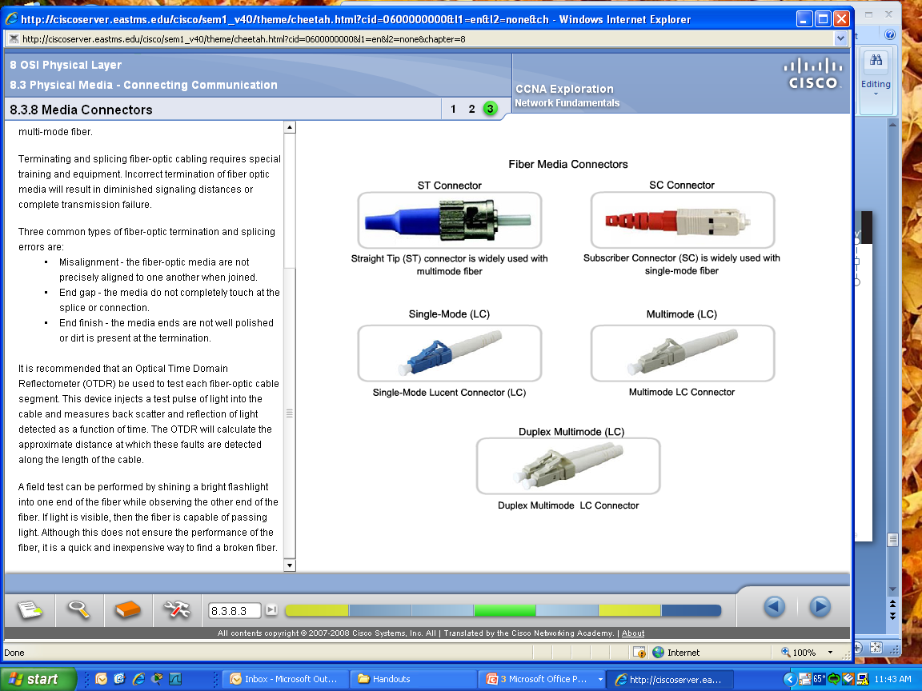
Fiber connectors

Slide 41
Testing Fiber
It is recommended that an Optical Time Domain Reflectometer (OTDR) be used to test each fiber-optic cable segment.
This device injects a test pulse of light into the cable and measures back scatter and reflection of light detected as a function of time.
If you don’t have an OTDR, shine a flashlight into one end of the fiber and observe the other end. If you see light, the fiber is capable of passing light.

